Slide 1
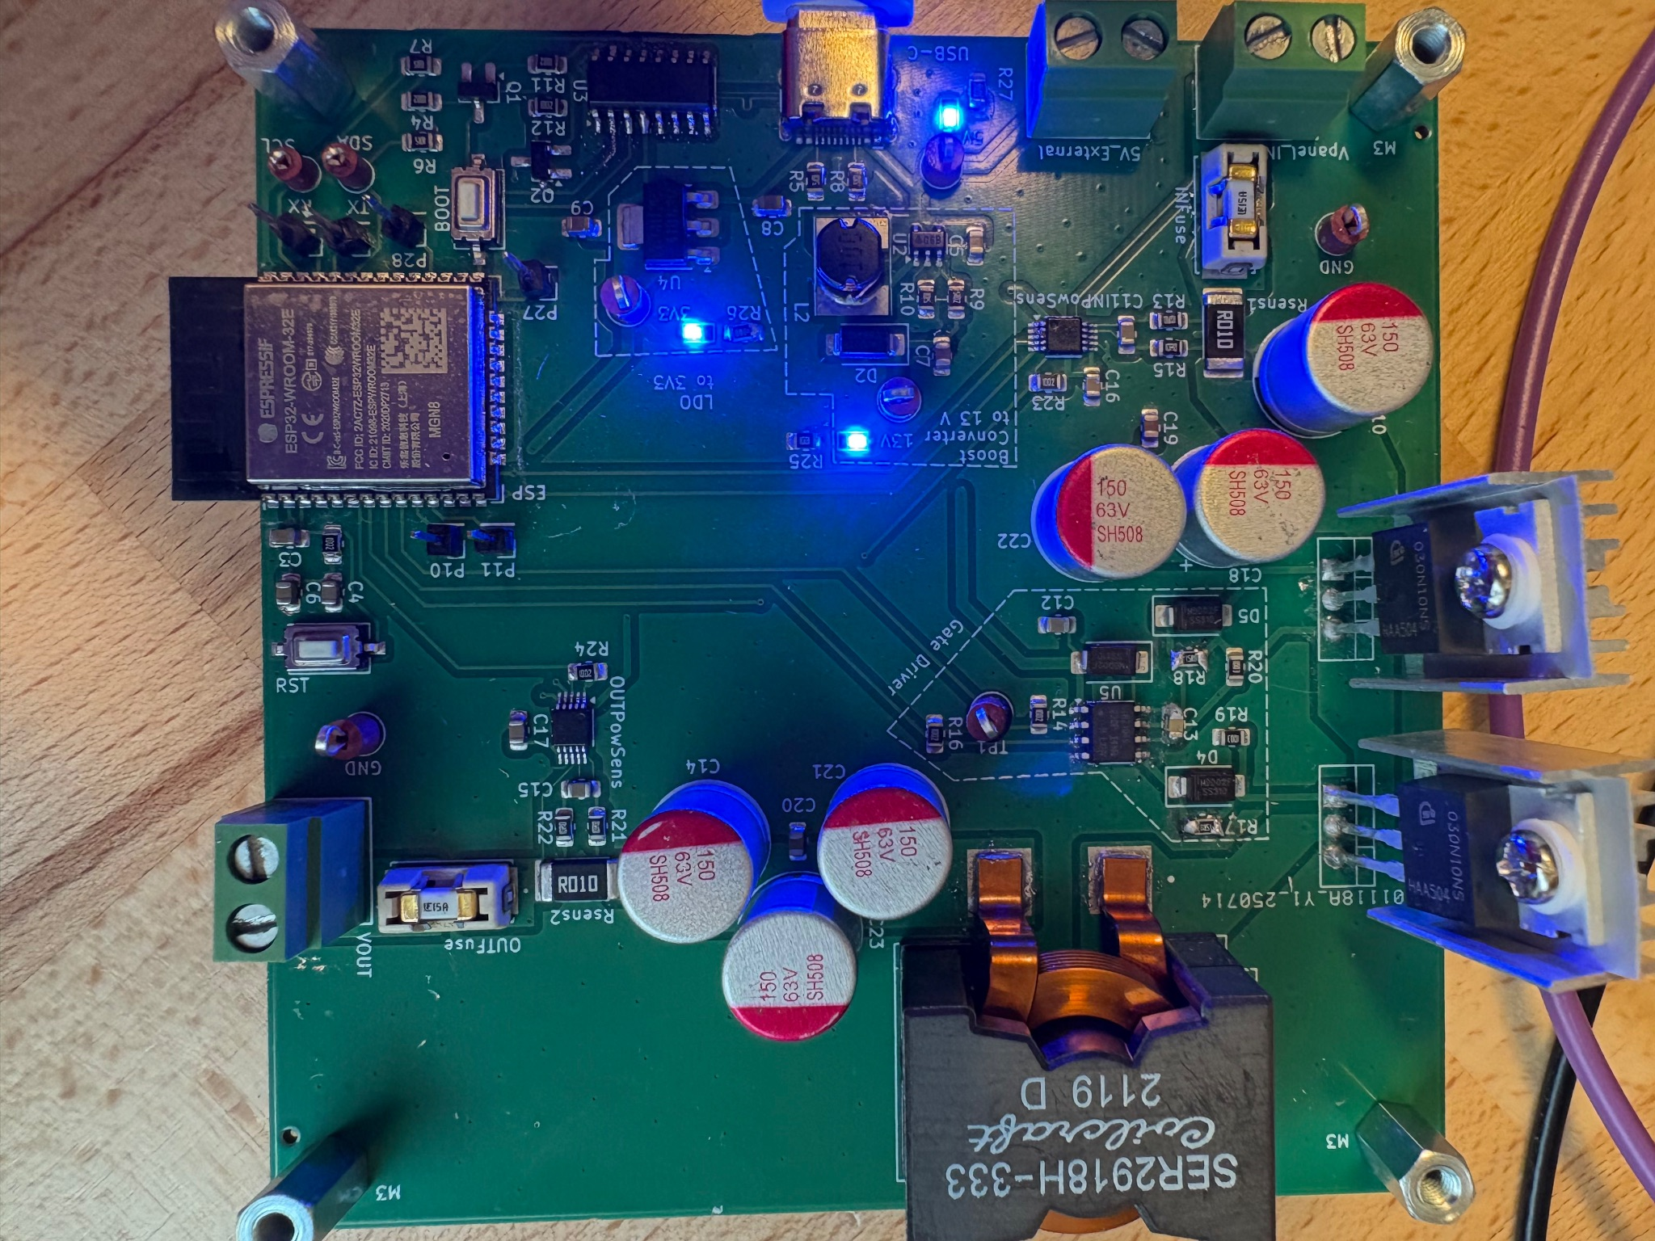
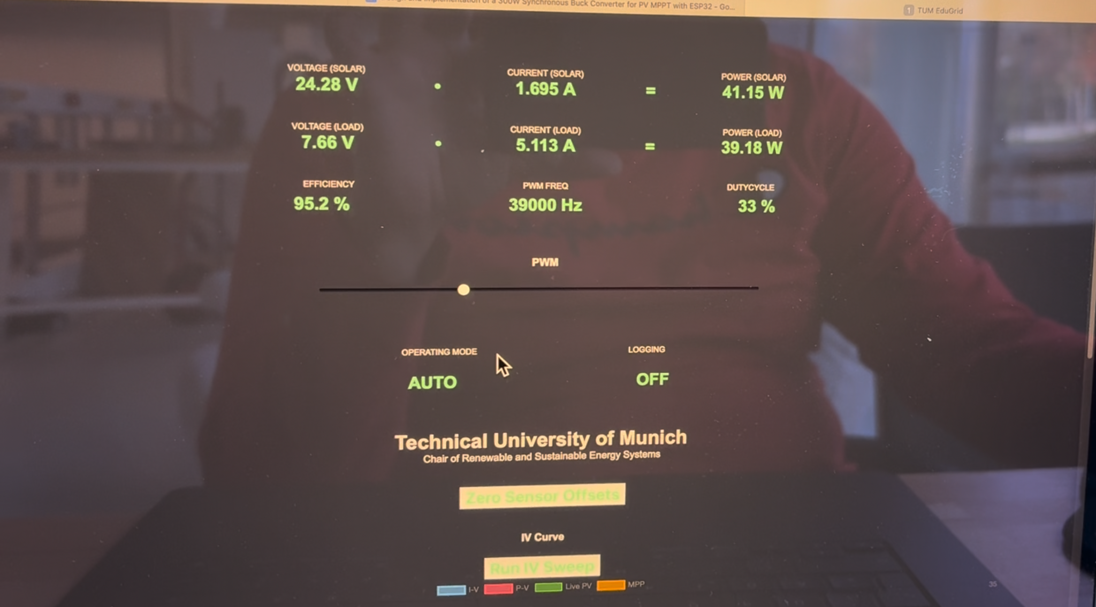
Design and Implementation of a 300 W
Educational MPPT Synchronous Buck
Converter with ESP32 Control

Slide 2
Outline
Motivation, System Specifications and Objectives
Hardware design (power stage, sensors, aux rails) / PCB Strategy
Firmware Architecture, Measurement & MPPT algorithm and Web UI
Validation & performance
Demo, repo & resources
Conclusions and future work

Slide 3
Motivation, System Specifications and Objectives
Goal : Design a robust 300W Synchronous Buck Converter for MPPT applications which also need to be educationally simple by providing visual, debuggable and extendable system for labs
End-to-end development including schematic design, component selection, PCB layout, firmware (ESP32), and web-based visualization.

Slide 4
System Specifications and Objectives
Design a 300 W synchronous buck converter for PV MPPT
Implement MPPT (Perturb & Observe) on ESP32 with web UI IV Curve
Provide precise input/output sensing (dual INA228)
Make design teachable: clear PCB silkscreen, test points, visualizations

Slide 5
Hardware Design
Topology and Key Choices
Gate Drive Network
Sensing : Dual INA228 Setup
Auxiliary Supplies
PCB and Layout Decisions

Slide 6
Topology and Key Choices
Synchronous Buck : Chosen for efficiency (MOSFET synchronous rectification) lower loss than a regular diode buck.
MOSFET Selection: IPP030N10NF2SAKMA1 (NMOS).
Selected for low RDS(on)​ to minimize conduction losses. High enough Voltage and high current capability.
Inductor & Capacitors:
High saturation current inductor to ensure linear behavior.
Aluminum-polymer capacitors for low ESR and high ripple current capability.
Solar Panel JWS-Solar 1210, which can reach an open-circuit voltage of 38.8, a short-circuit current of 9.4 A, and operates at a maximum power point (MPP) of 31.9 V and 8.9 A.

Slide 7
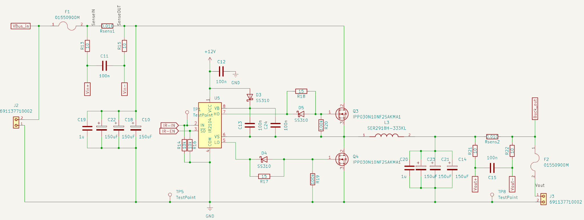
Gate Drive Network
Gate Driver: IR2104 High/Low-side driver synchronous driver with bootstrap circuit.
By applying one pwm input it can drive two MOS synchronously. Internal deadtime (~540ns) to prevent shoot-through.
Asymmetrical Gate Drive: Implemented using a Series Resistor for slower turn-on (reduced ringing) and a Schottky Diode (SS310) for fast turn-off (reduced switching loss).
Bootstrap to control the hide side mosfet.
100 kΩ gate-to-source discharge resistor.

Slide 8
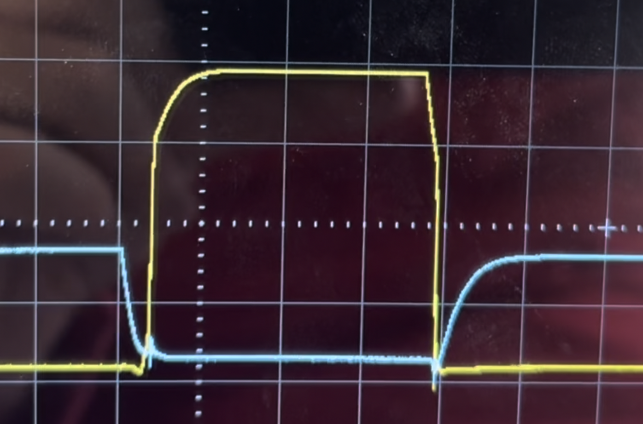

Slide 9
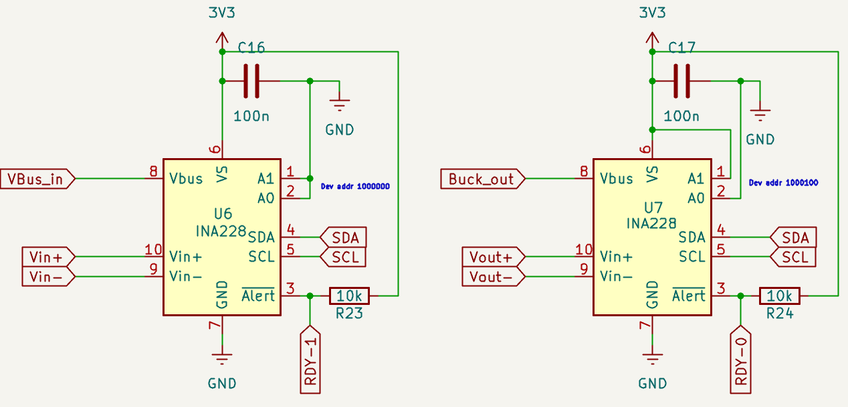
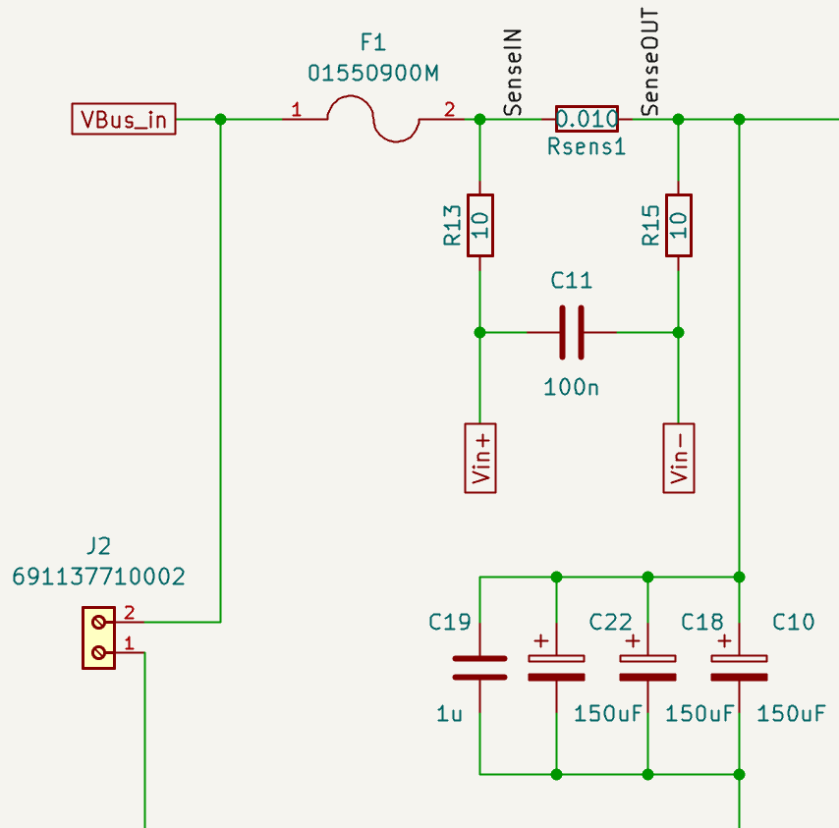
Sensing : Dual INA228 Setup
Two INA228 (85V) power monitors (input and output) via I²C to ESP 32
0.01 Ω shunt resistors -> full-scale ≈ 16.38 A (Well below our expected current)
Kelvin 4‑wire layout and input filtering to suppress noises
Tested with multimeter for the accuracy and it gives same result.

Slide 10
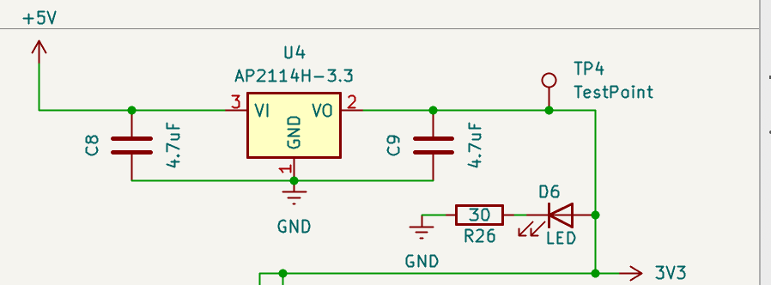
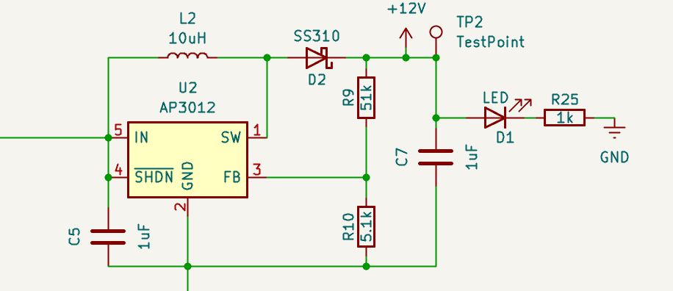
Auxiliary Supplies
The converter requires multiple auxiliary voltage rails to power different subsystems
IR2104 gate driver requires a supply voltage of at least 10 V
ESP32 microcontroller and INA228 power sensors operate at 3.3 V logic levels.
The primary input to the control board is the 5 V supply provided via the USB Type-C port, capable of delivering up to approximately 2 A in its default configuration. So an LDO for 3.3V small Boost converter for 13 V implemented
Also added external 5V input for powering up without usb connection

Slide 11
PCB and Layout Decisions
<(10 × 10 cm) 2-layer PCB optimized for cost and teachability
Educational Focus: Clear silkscreen labeling, test points for all critical signals (Gate, PWM, Vin​, Vout​), and logical component grouping. LEDs, silkscreen labels, M3 mounting holes
Power stage tightly grouped to minimize high-current loop area. Short, wide high-current loops; stitched vias and copper pours
Control electronics (ESP32) partitioned away from the noisy switching node.
Use of top and bottom copper fills with stitching vias for thermal management and current handling.

Slide 12
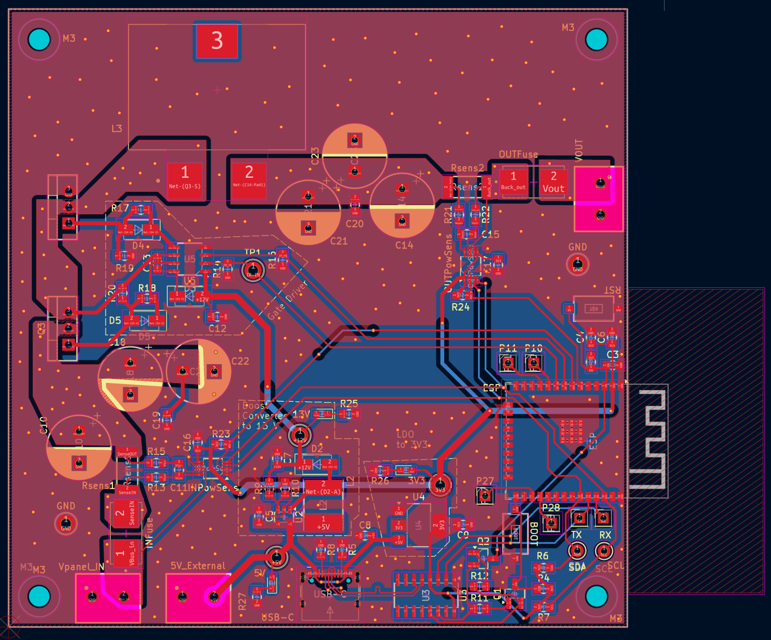
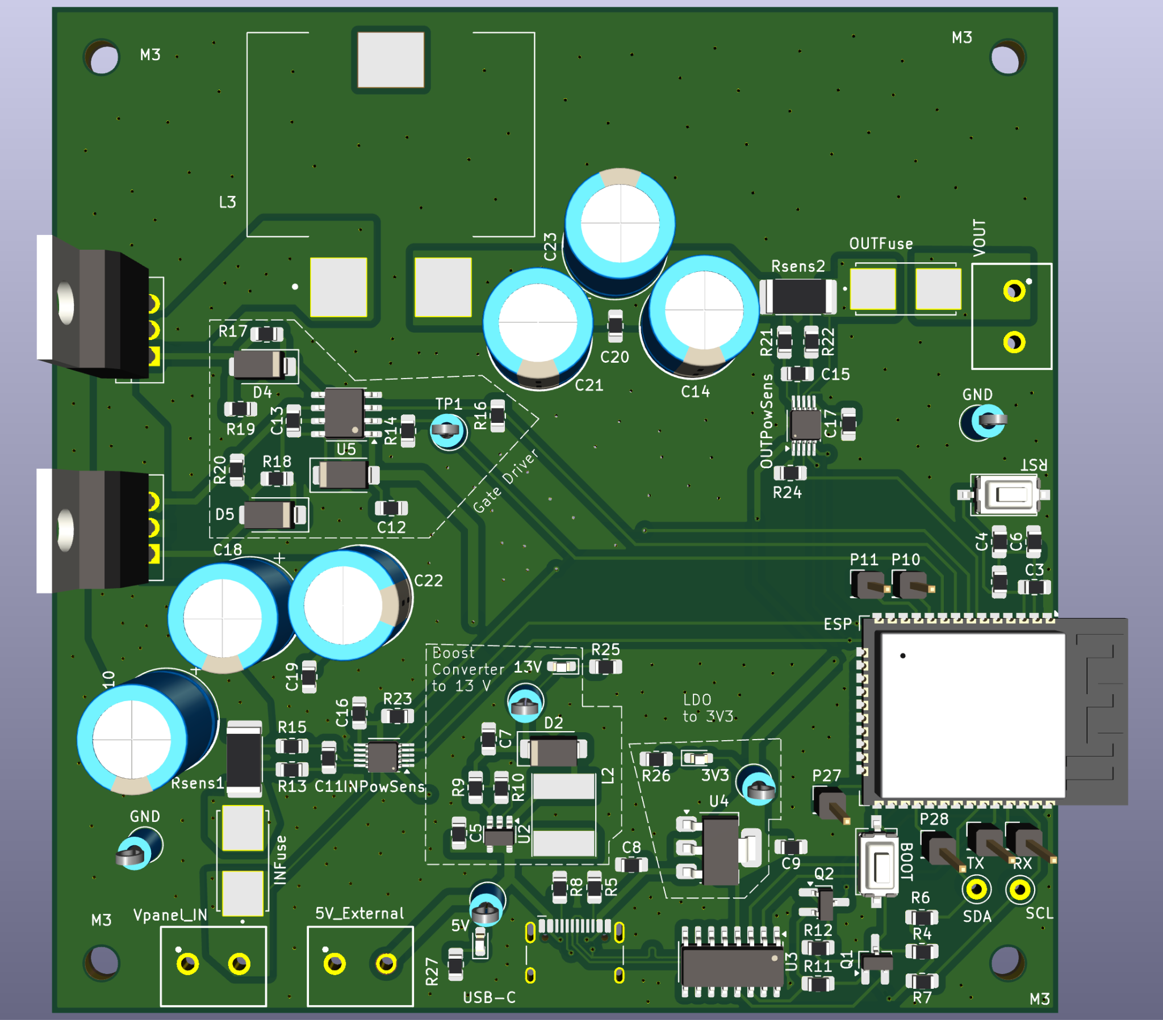

Slide 13
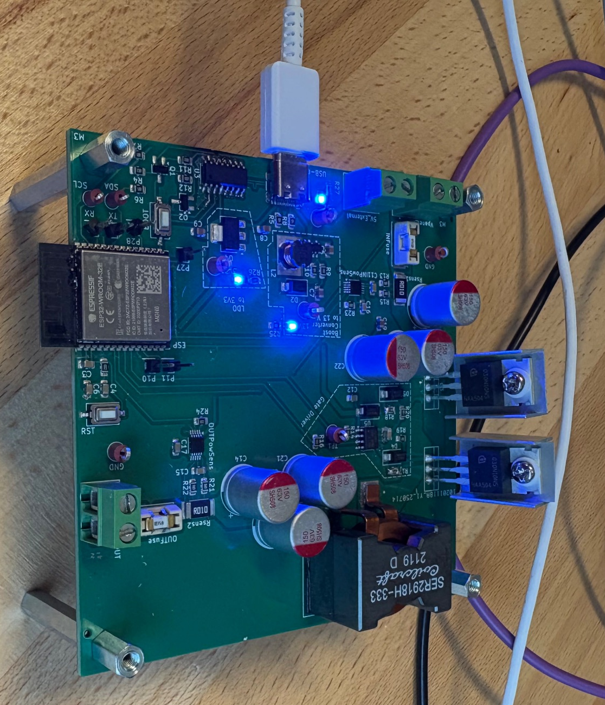

Slide 14
Firmware Architecture
Platform: Developed in C++ using VSCode PlatformIO and the Arduino Framework.
Modular Design: Separated into Filesystem, Measurement, MPPT Logic, PWM Control, and Webserver module for easier understandability and teaching.
Multitasking: Uses FreeRTOS tasks to separate time-critical control loops from background telemetry and live asynchronous web server to avoid blocking control loop
Connectivity: Supports USB-C (CH340C bridge) for serial debugging/programming and Wi-Fi for the Web UI.

Slide 15
MPPT Algorithm and Timing
Software clamps (PWM_MIN/MAX) and manual slew limits to avoid high voltage stress on instant changes.
AUTO mode: Perturb & Observe (hill-climb), chosen for simplicity and teachability.
IV_SWEEP: full duty sweep (5%→95%) for IV/PV curves capture
MANUAL: User-controlled slider with software slew limiter
Sensor Timing:
INA228 conversion time: 1,052μs×2 (Bus + Shunt) ×128 averages ≈270ms + Added settling time: 120ms so Total Step Period: 390ms. The MPPT algorithm updates the duty cycle exactly once per period to ensure stable readings. For educational visualization, stability is more important than sub-millisecond tracking speed.
Calibration: Automated zero-offset calibration routine runs at startup to compensate for bias errors.

Slide 16
Web UI And Visualization
Single Page Application served from LittleFS (HTML/CSS/JS + Chart.js) Responsive UI without reloading the page great for real-time settings and charts.
Live IV/PV charts, MPP marker, last 10 operating points highlighted
Uses WebSockets based telemetry to push live telemetries (Voltage, Current, Power, Efficiency) without page reloads, for low-latency live updates.
Asynchronous WebServer hosting HTML/JS on the ESP32 for live running.
Used Chart.js for visualization of live IV/PV charts, MPP marker, green dot indicator for the real-time Operating Point and last 10 operating points highlighted

Slide 18
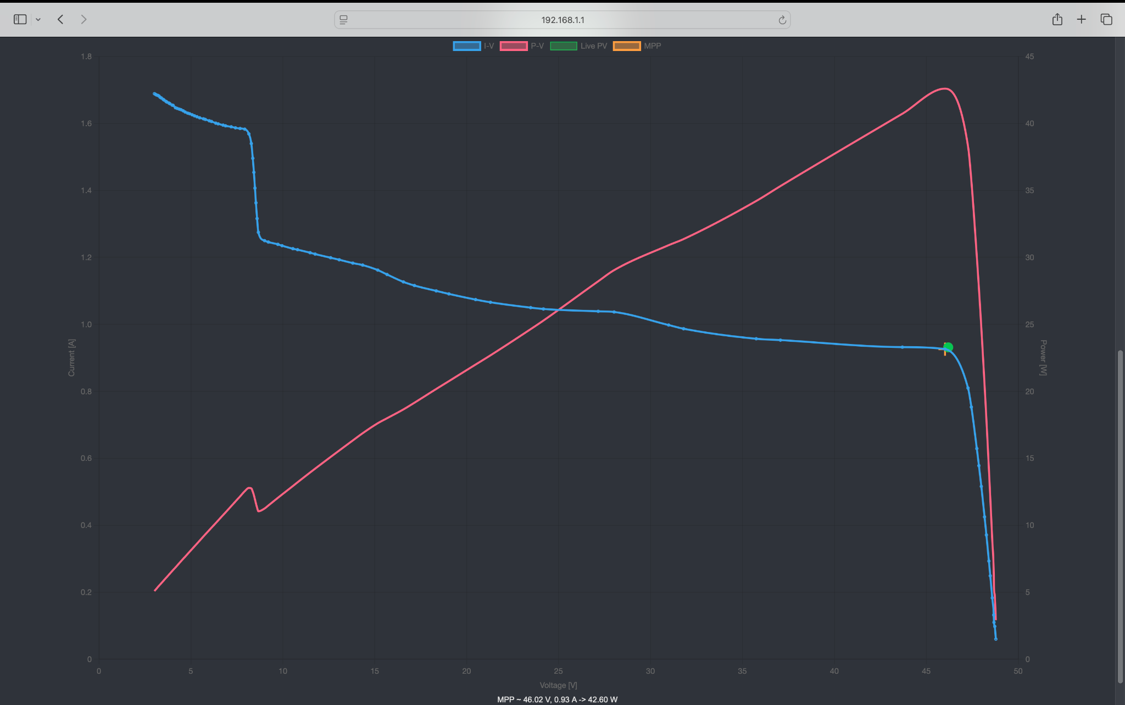

Slide 19
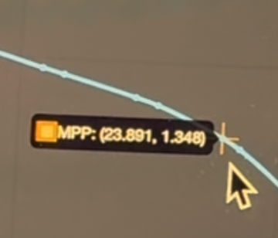
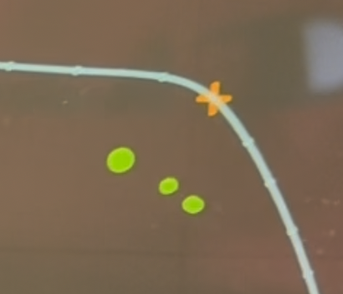

Slide 20
Validation and Performance Test
Oscilloscope Verification: Confirmed complementary high/low-side switching with correct deadtime and no shoot-through.
Initial zero-offset calibration routine at power-up
Sensor accuracy: validated with multimeter checks
Efficiency: Achieved peak efficiency of ~95% around the Maximum Power Point.
Tracking Accuracy: The P&O algorithm reliably finds the MPP within the 1% duty-cycle resolution and update every 390 ms.
Thermal: Stable operation, with copper pours acting as effective heatsinks. Also mechanical heatsinks helps for mosfet heating

Slide 21
Resources and Available Files/Videos
Github: https://github.com/UtkuDenizAltiok/EDUGrid_Final PCB Files, Report Document, Codes and This Slide included
Youtube Demo Video : https://youtu.be/TUlADqGg1uM

Slide 22
Future Work and Conclusions
Implement advanced MPPT algorithms (incremental conductance, model-based)
Thermal management improvement (box with a fan) and higher power variants
Add fault detection & protection (overcurrent, temp, PV isolation)
Add battery charging profile support and energy storage integration
Achievement: Successfully designed and validated a fully functional 300W (efficiency ~95%) MPPT synchronous buck converter from scratch with precise sensing and an ESP32-based UI.
System validated with oscilloscopes, multimeters and load tests
Educational Impact: The device serves as a "glass box" tool—students can see the hardware (PCB visualizations), modify the open-source firmware, and visualize the physics (Web UI IV curves). Open-source repo and demo video provided for reproducibility and teaching

